Slide 1
Systems with Uncertainty

Slide 2
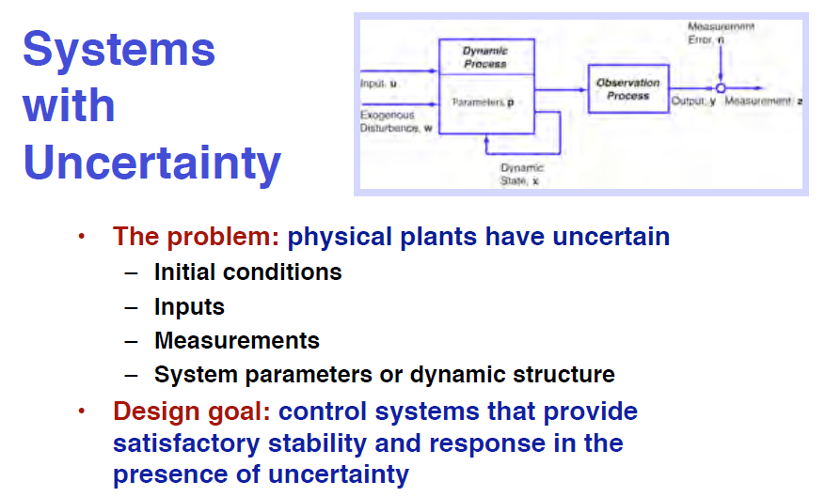

Slide 3
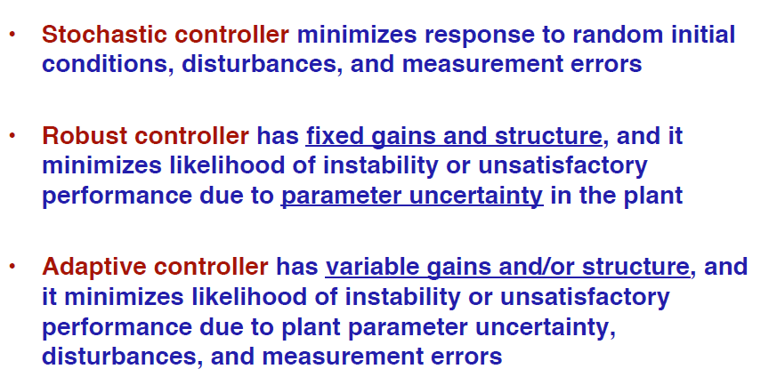
What are “Stochastic, Robust, and Adaptive” Controllers?

Slide 4
Stochastic Optimal
Control

Slide 5
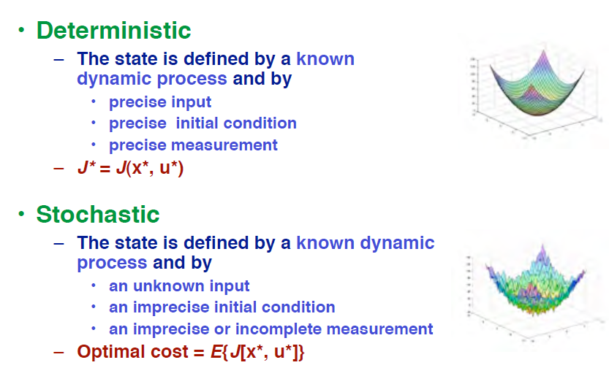
Deterministic versus Stochastic Optimization

Slide 6
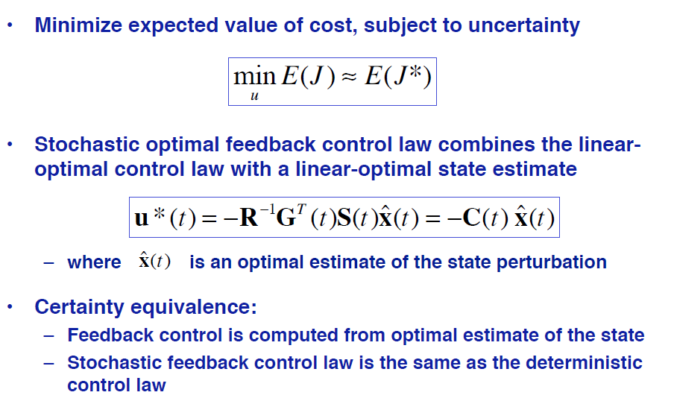
Linear-Quadratic Gaussian (LQG)
Optimal Control Law

Slide 7
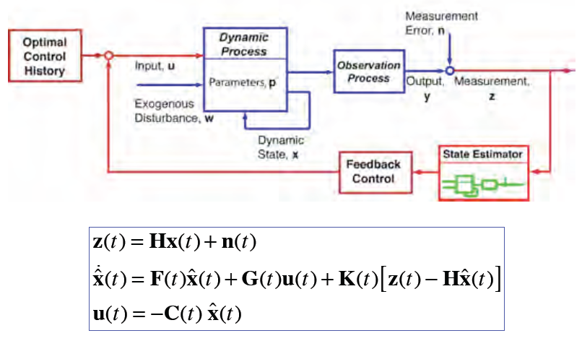
Linear-Quadratic-Gaussian Control of a Dynamic Process
H

Slide 8
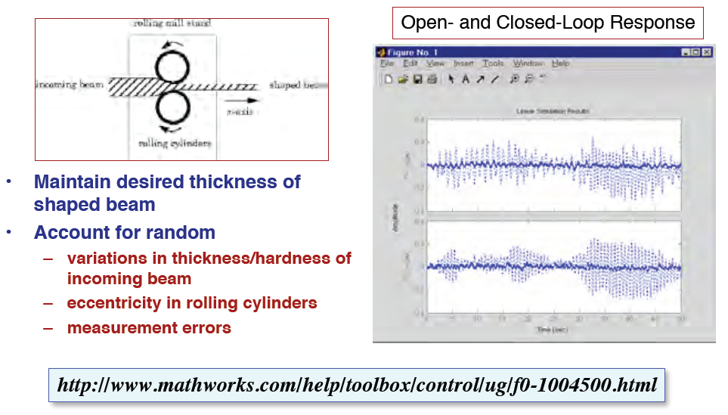
LQG Rolling Mill Control System Design Example

Slide 9
Stochastic Robust
Control

Slide 10
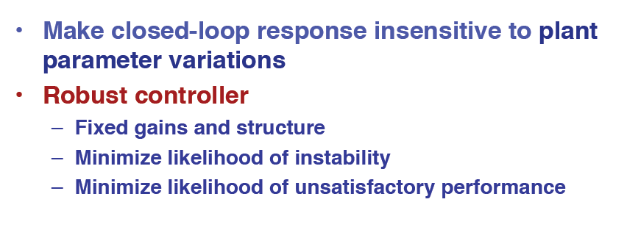
Robust Control System Design

Slide 11
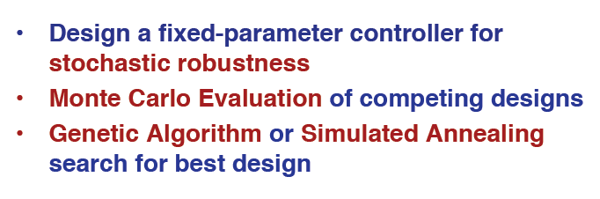
Probabilistic Robust Control Design

Slide 12
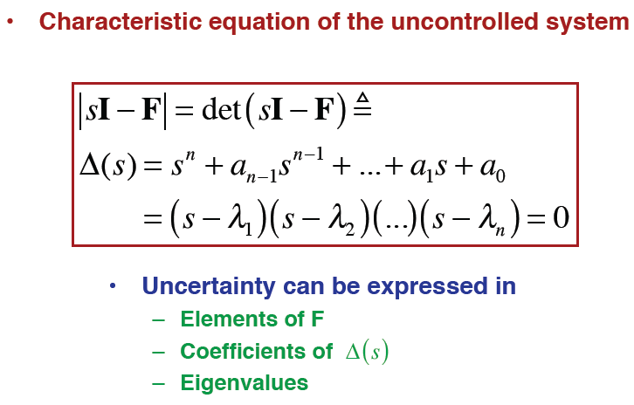
Representation of Uncertainty

Slide 13
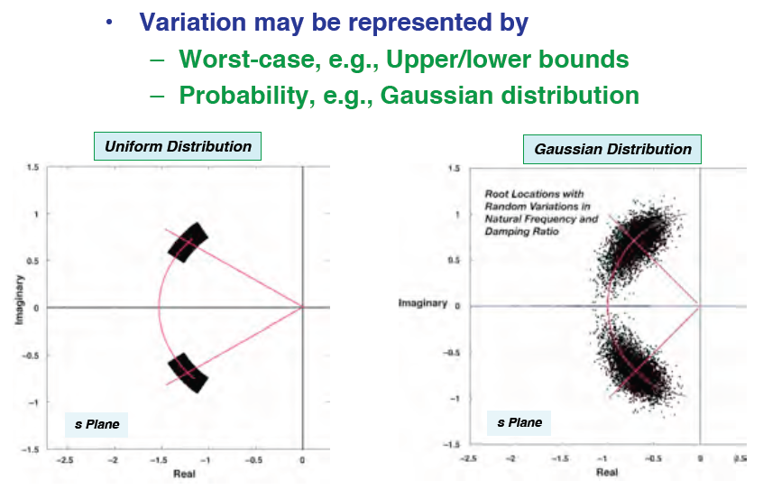
Root Localizations for an Uncertain System

Slide 14
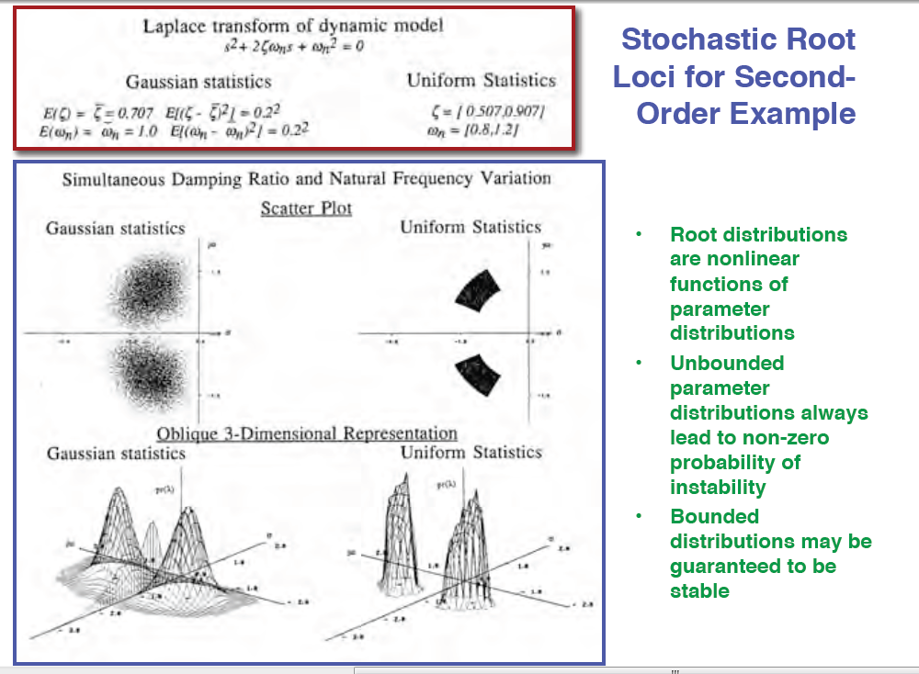

Slide 15
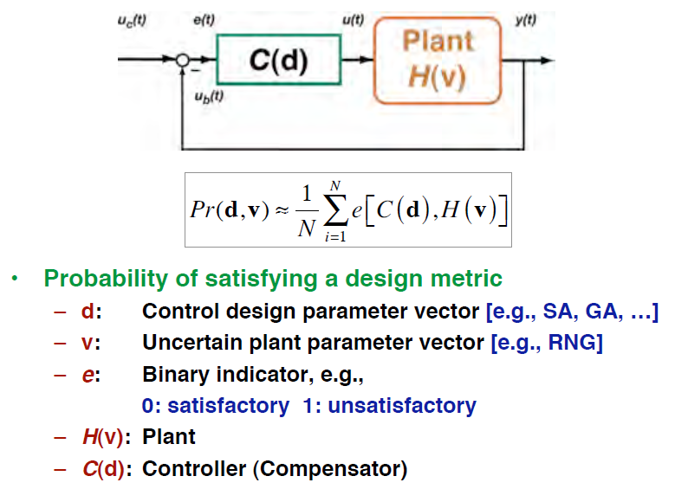
Probability of Satisfying a Design Metric

Slide 16
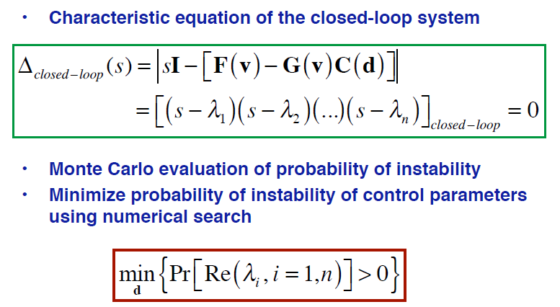
Design Control System to Minimize Probability of Instability

Slide 17
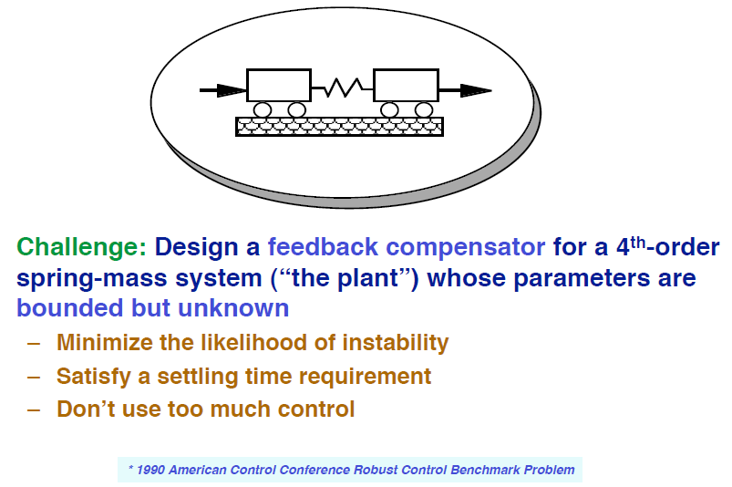
Control Design Example *

Slide 18
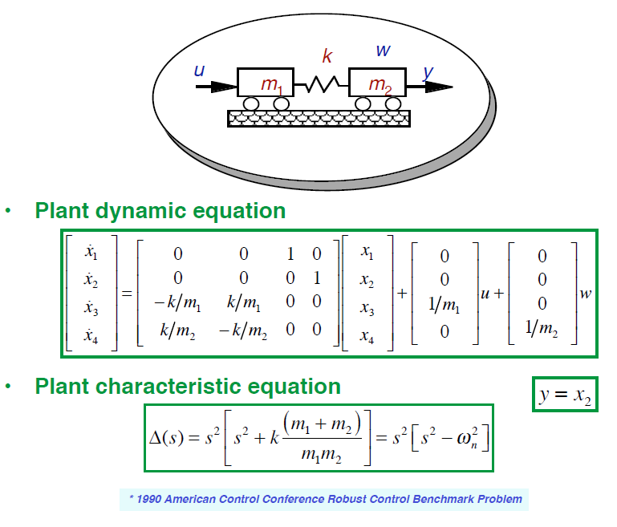
Uncertain Plant *

Slide 19
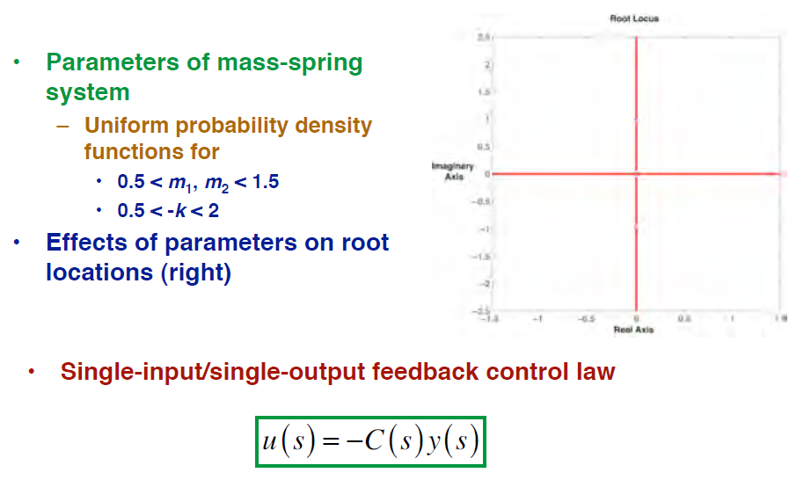
Parameter Uncertainties, Root Locus, and Control Law

Slide 20
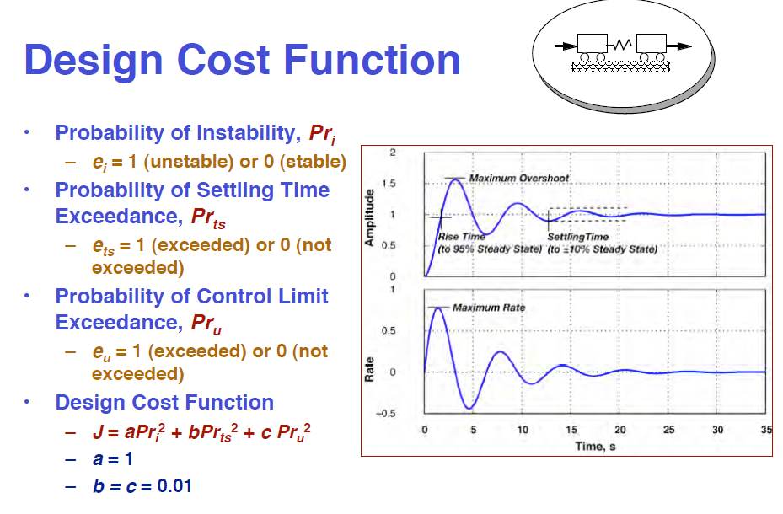

Slide 21
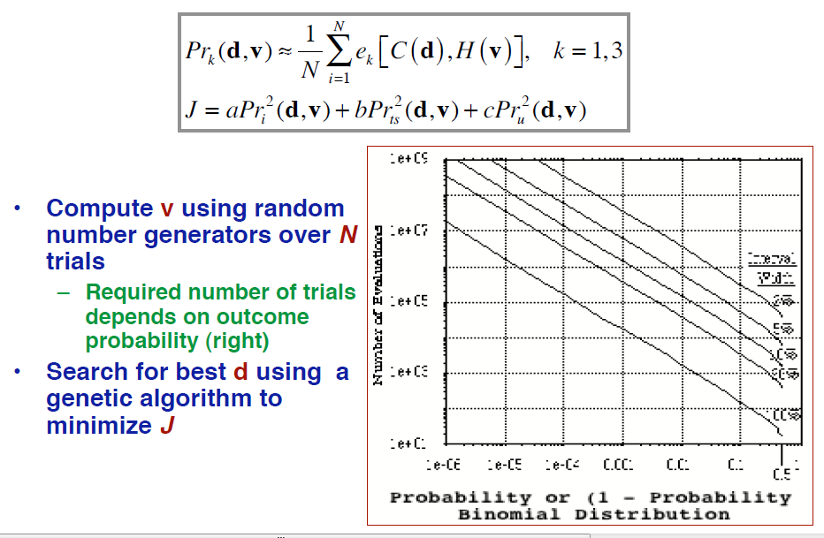
Monte Carlo Evaluation of Probability of Satisfying a Design Metric

Slide 22
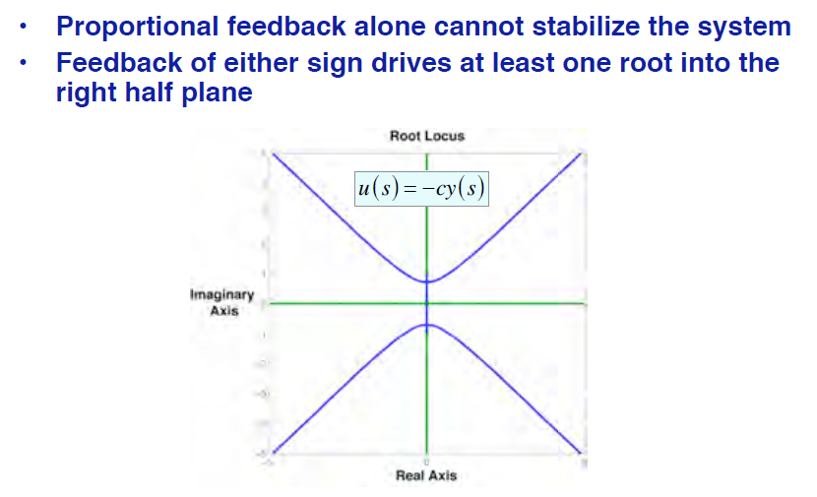
Stabilization Requires Compensation

Slide 23
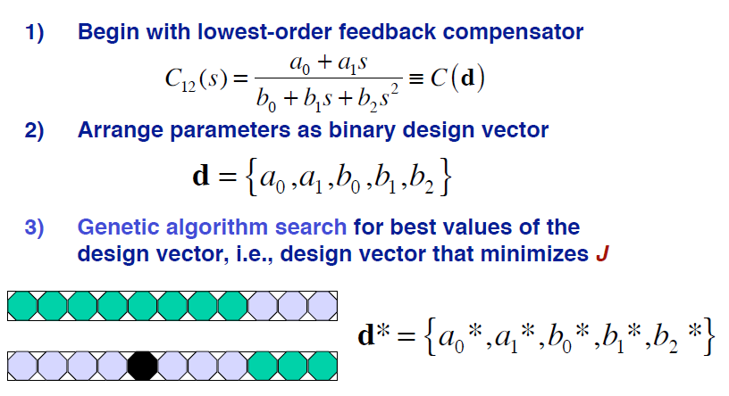
Search-and-Sweep Design of Family of Robust Feedback Compensators

Slide 24
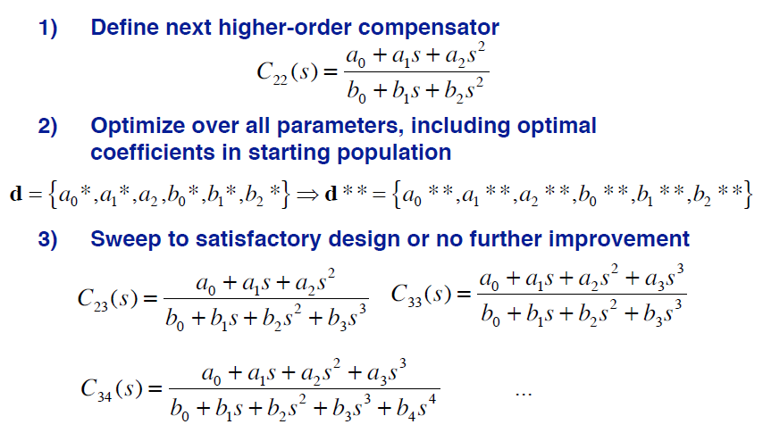
Search-and-Sweep Design of Family of Robust Feedback Compensators

Slide 25
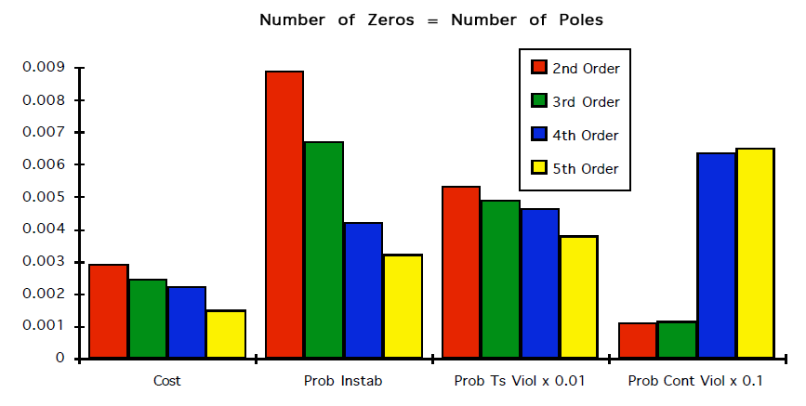
Design Cost and Probabilities for Optimal 2nd – to 5th –Order Compensators

Slide 26
System Identification

Slide 27
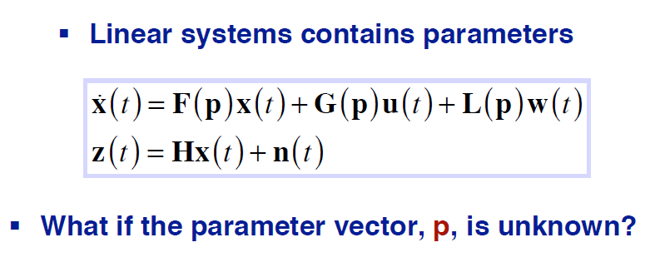
Parameter-Dependent Linear System

Slide 28
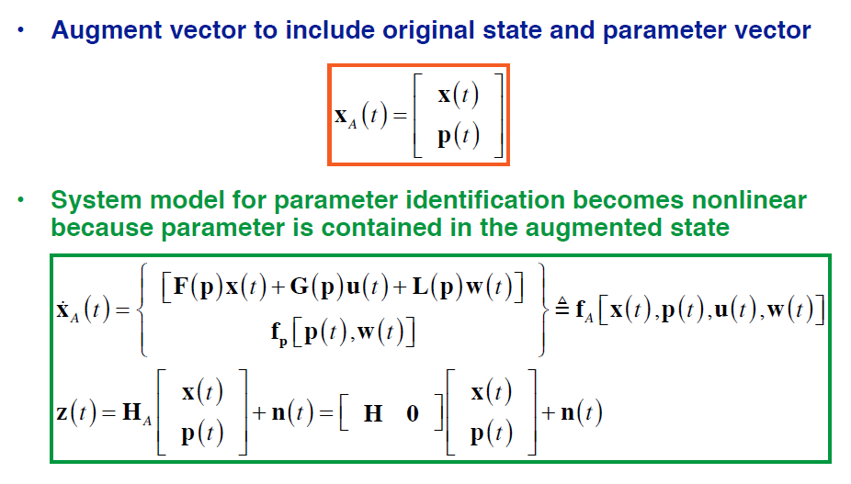
Dynamic Model for Parameter Estimation

Slide 29
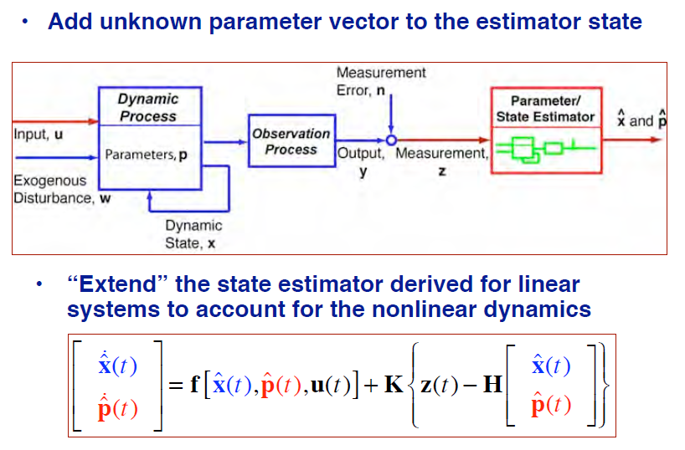
System Identification Using an Extended Kalman-Bucy Filter

Slide 30
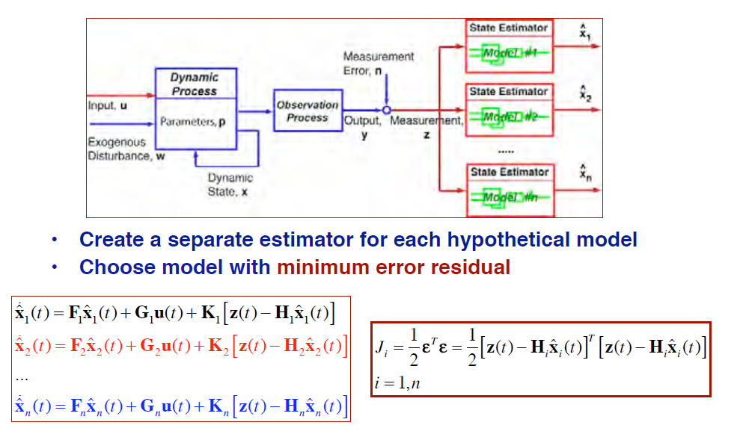
Multiple-Model Testing for System Identification

Slide 31
Adaptive Control

Slide 32
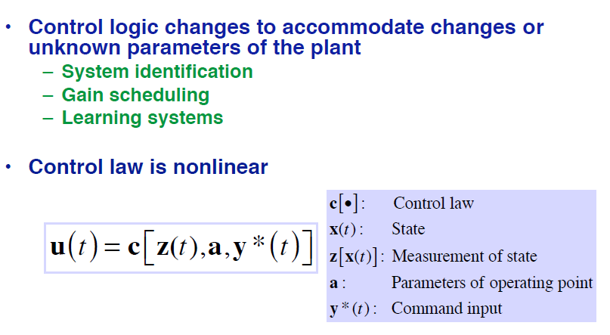
Adaptive Control System Design

Slide 33
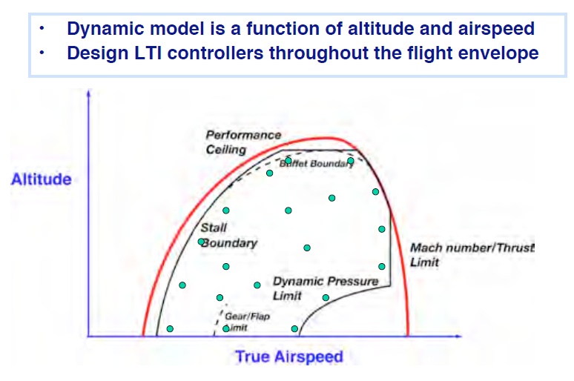
Operating Points Within a Flight Envelope

Slide 34
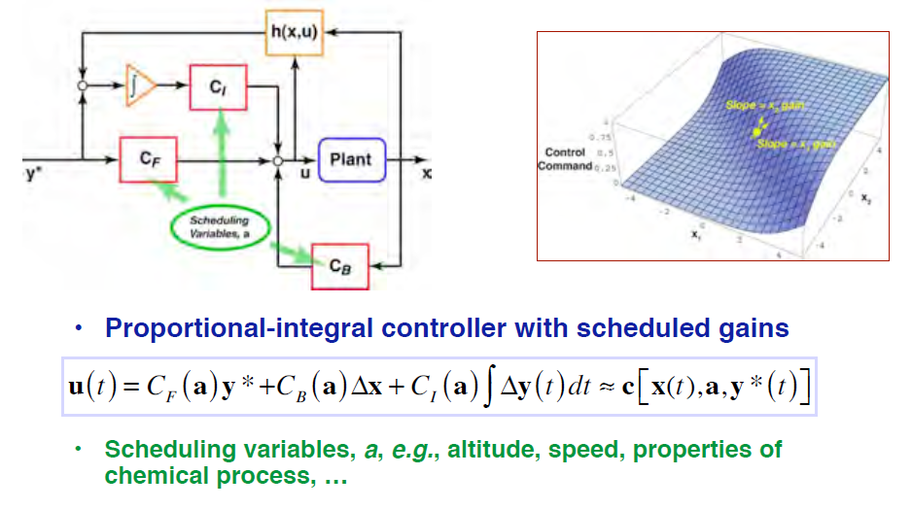
Gain Scheduling

Slide 35
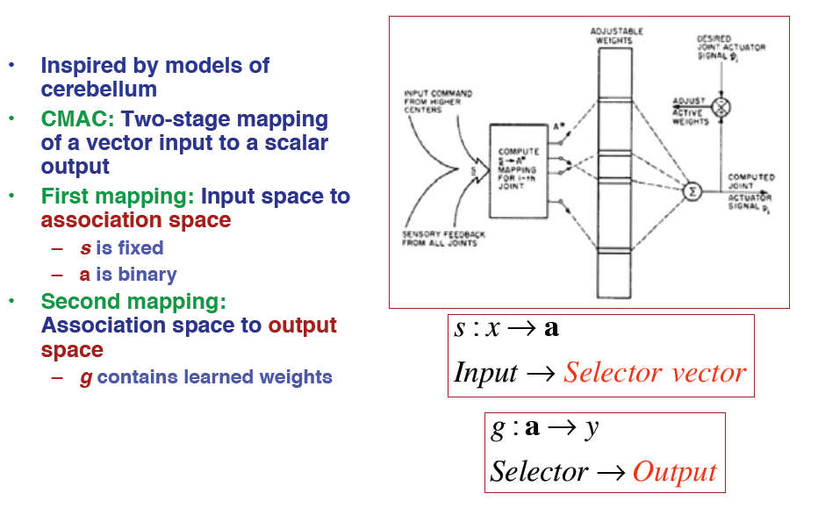
Cerebellar Model Articulation Controller (CMAC)

Slide 36
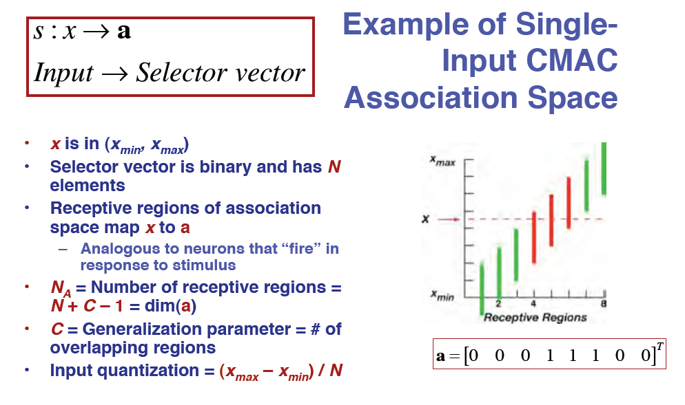

Slide 37
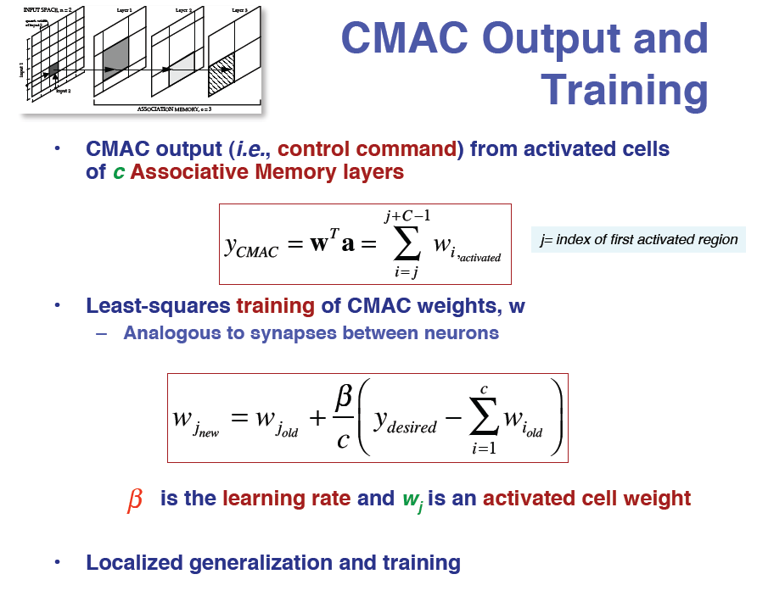

Slide 38
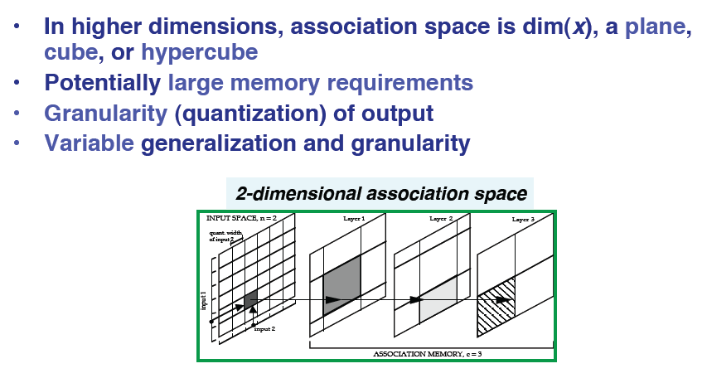
CMAC Output and Training

Slide 39
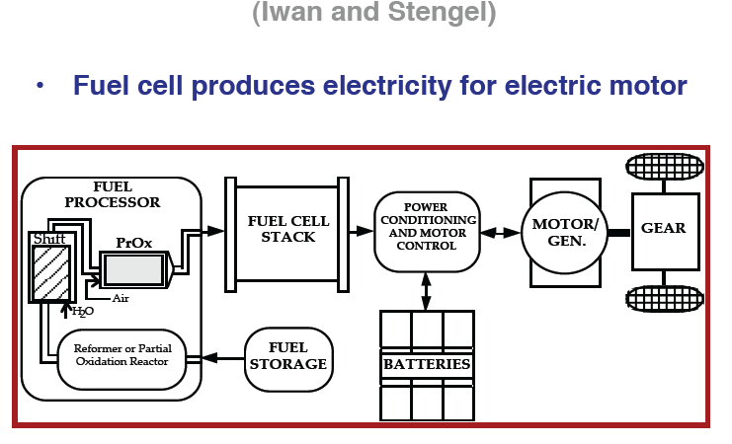
CMAC Control of a Fuel-Cell Pre-Processor

Slide 40
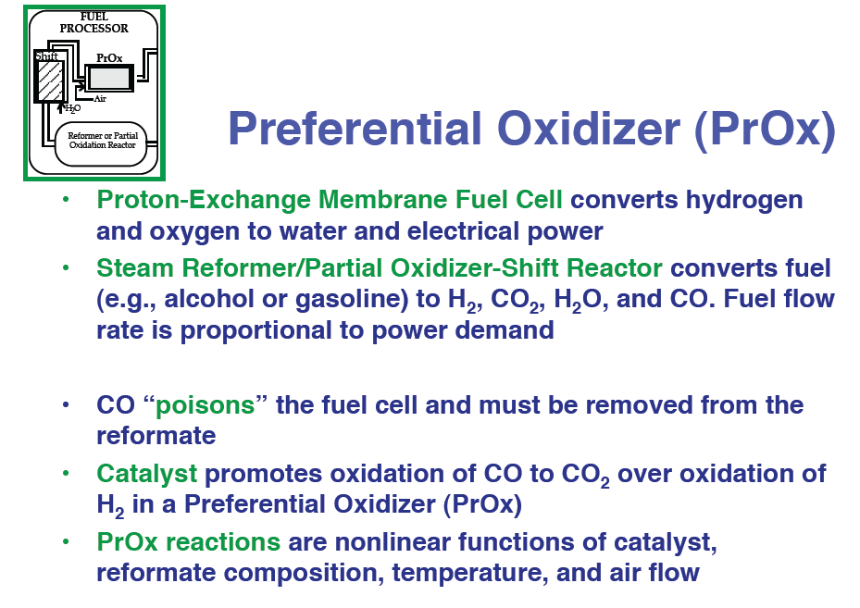

Slide 41
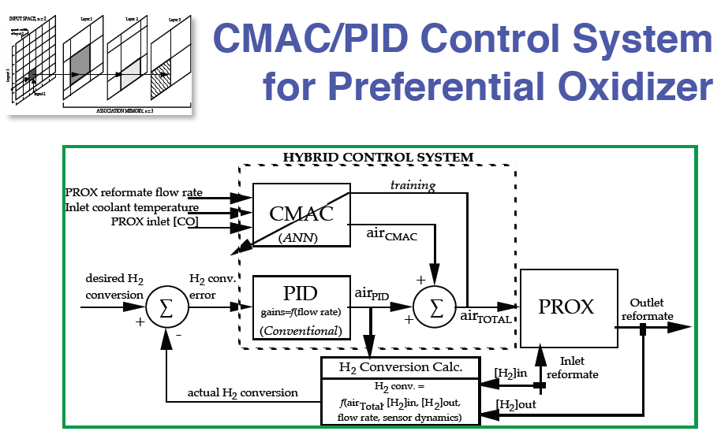

Slide 42
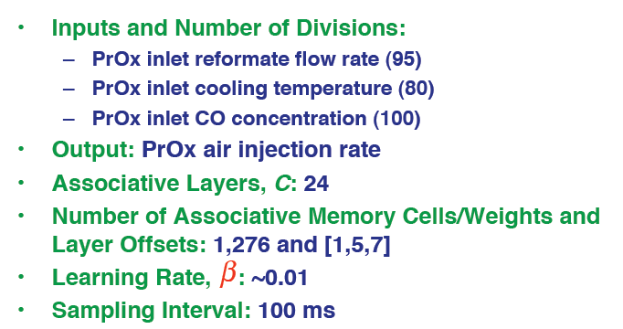
Summary of CMAC Characteristic

Slide 43
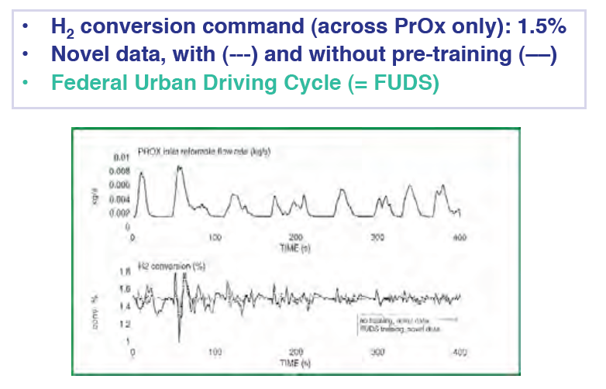
Flow Rate and Hydrogen Conversion of CMAC/PID Controller

Slide 44
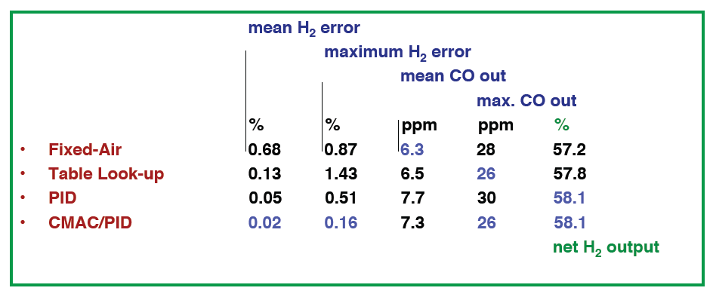
Comparison of PrOx Controllers on FUDS

Slide 45
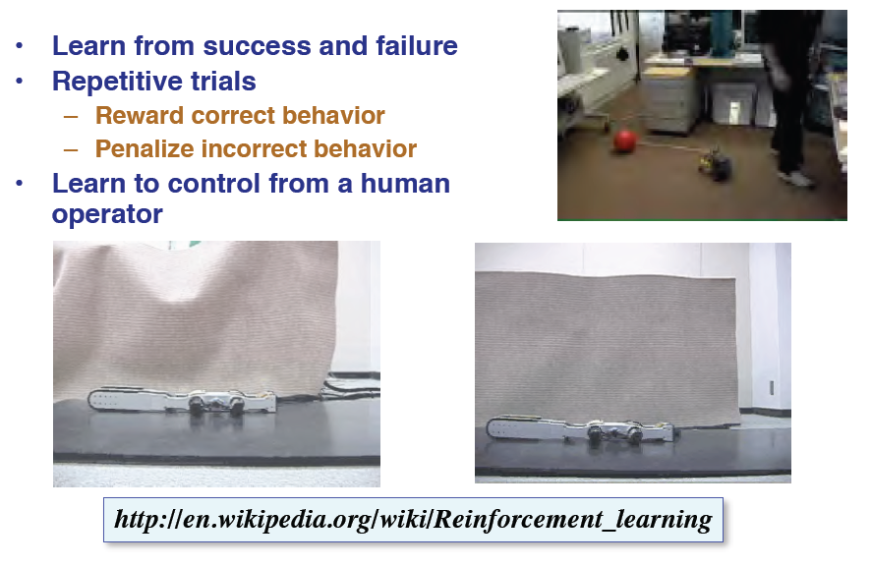
Reinforcement Learning

Slide 46
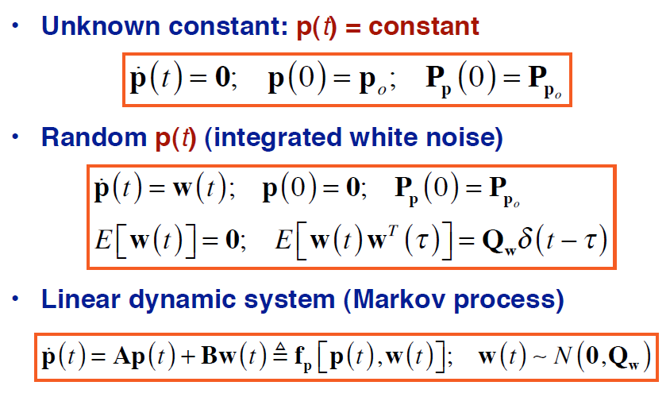
Dynamic Models for the Parameter Vector

Slide 47
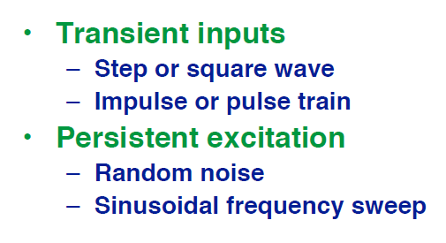
Inputs for System Identification

Slide 49
